Slide 1
30-Day Decompensation
MLOps 1.6

Slide 2


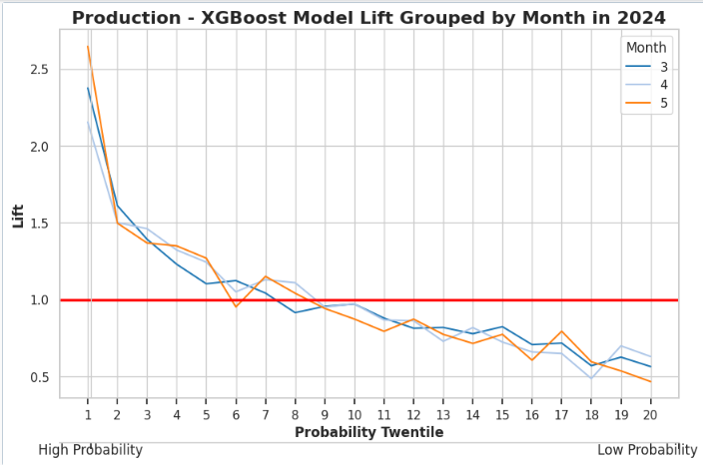



Azure Databricks Pre-Prod Workspace [vac20brickscdwoccds201]
Scenario: No Prod Model yet; However, Initial Dev Model performance is consistent and reliable.
Decompensation 1.6 [Step 1] Retrain (Task)
Model Retrain
Decompensation 1.6 [Step 2] Dev (Scheduled)
Feature Store
Inference
Validation
Feature Store
Inference
Validation
Validation

Slide 3
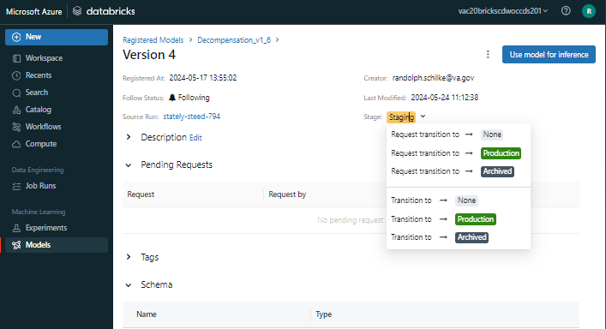
Scenario: Transition successful Dev model to Production; After GUI click, version 4 model and all files move to the production pipeline. New Dev model is retrained.
Azure Databricks Pre-Prod Workspace [vac20brickscdwoccds201]
Decompensation 1.6 [Step 1] Retrain (Task)
Model Retrain
Decompensation 1.6 [Step 2] Dev (Scheduled)
Feature Store
Inference
Validation
Decompensation 1.6 [Step 3] Dev (Trigger)
Decompensation 1.6 [Step 4] Prod (Scheduled)
HTTPS Webhook
Move Files From Dev folder to Prod folder
Feature Store
Inference
Validation
Validation

Slide 4
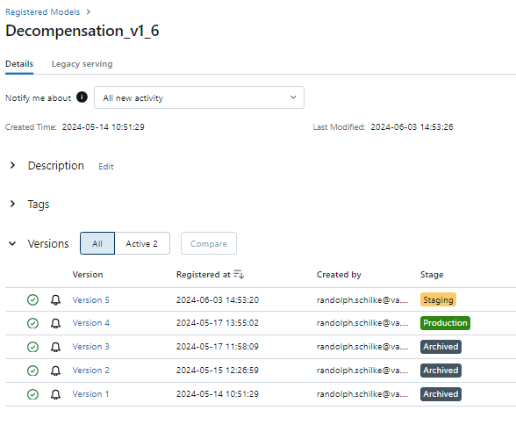
Azure Databricks Pre-Prod Workspace [vac20brickscdwoccds201]
Scenario: visually demonstrating MLFlow model management. Version 5 model “Staging” is in Dev pipeline. Version 4 model “Production is in Prod pipeline.
Model Retrain
Decompensation 1.6 [Step 2] Dev (Scheduled)
Feature Store
Inference
Validation
Feature Store
Validation
Decompensation 1.6 [Step 4] Prod (Scheduled)
HTTPS Webhook
Move Files From Dev folder to Prod folder
Feature Store
Inference
Validation
Validation

Slide 5
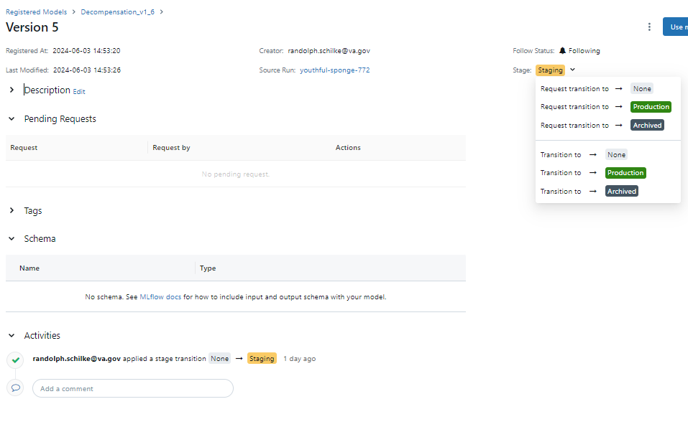
Azure Databricks Pre-Prod Workspace [vac20brickscdwoccds201]
Decompensation 1.6 [Step 1] Retrain (Task)
Model Retrain
Decompensation 1.6 [Step 2] Dev (Scheduled)
Feature Store
Inference
Validation
Decompensation 1.6 [Step 3] Dev (Trigger)
Decompensation 1.6 [Step 4] Prod (Scheduled)
HTTPS Webhook
Move Files From Dev folder to Prod folder
Feature Store
Inference
Validation
Validation

Slide 6
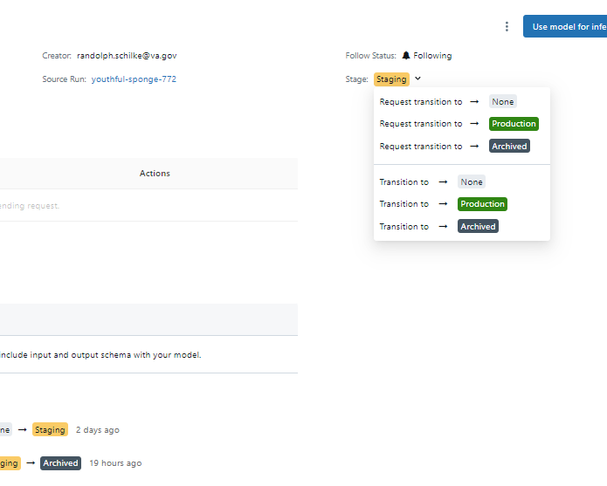
Azure Databricks Pre-Prod Workspace [vac20brickscdwoccds201]
Decompensation 1.6 [Step 1] Retrain (Task)
Model Retrain
Decompensation 1.6 [Step 2] Dev (Scheduled)
Feature Store
Inference
Validation
Scenario: Prod Model is okay; However, Dev Model is failing. We need to remove Dev Model to kick off retrain.
Decompensation 1.6 [Step 4] Prod (Scheduled)
Feature Store
Inference
Validation
Validation

